Slide 1


Pre-K – 12
Instructional Program and Athletics Program
Mr. Scott Storey
March 10, 2025

Slide 2
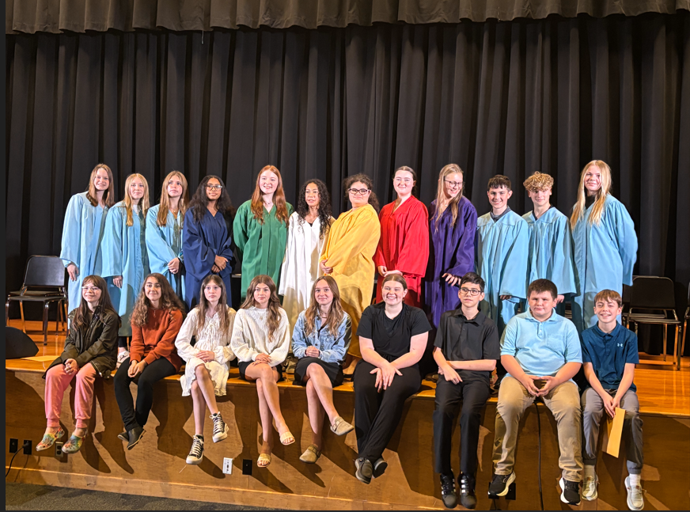
Instructional Budget Trends - March 10, 2025
Enrollment
PK-6 Staffing
7-12 Staffing
Athletics

Slide 3
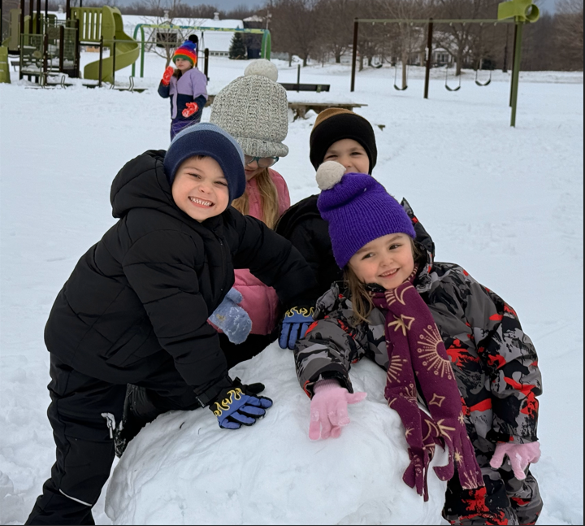
Enrollment Pre-K through Grade 12
2017-2018 478 students
2018-2019 484 students
2019-2020 497 students
2020-2021 492 students
2021-2022 500 students
2022-2023 502 students
2023-2024 502 students
2024-2025 489 students
2025-2026 Anticipated 488 students

Slide 4
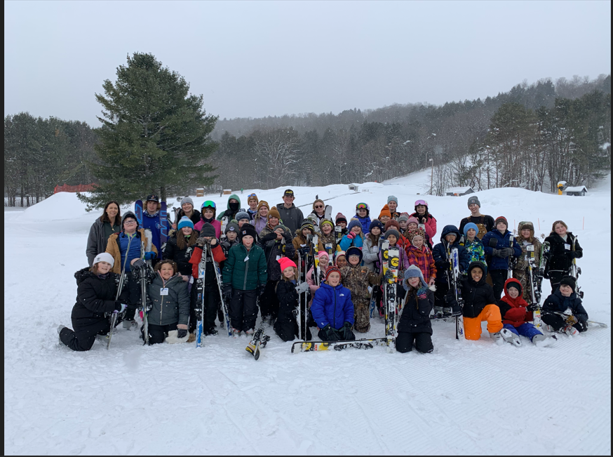
Enrollment Points
The enrollment presented includes Pre-K through Grade 12 students.
Enrollment over the past eight years has remained steady between 478 – 502 students.
Data was acquired via the New York State School Report Card.

Slide 5
PK-6 Teaching Staff
PK K 1st 2nd 3rd 4th 5th 6th Total
2017-2018 1 2 2 2 2 2 2 2 15
2018-2019 1 2 2 2 2 2 2 2 15
2019-2020 1 2 2 2 2 2 2 2 15
2020-2021 1 2 2 2 2 2 2 2 15
2021-2022 1 2 3 2 2 3 3 3 19
2022-2023 1 2 3 2 2 2 3 3 18
2023-2024 1 2 2 2 2 2 2 2 15
2024-2025 1 2 2 2 2 2 2 2 15
2025-2026 1 2 2 2 2 2 2 2 15

Slide 6

PK-6 Teaching Staff Points
Number of staff members has been consistent over the past eight years.
During COVID years and to make up for learning loss, COVID monies were used to add additional teachers.
Since COVID, the number of teachers of PK-6 students was balanced back to 15.

Slide 7
7-12 Teaching Staff
Not including Special Education & AIS Teachers
        ELA & Math & Spanish Ag/Tech Art/Music Health Library Total for year
        Social St Science French Business PE ENL
2017-2018 4 6 2 3 4 1 2 22
2018-2019 4 6 2 3 4 1 2 22
2019-2020 4 6 2 3 4 1 2 22
2020-2021 4 6 2 3 4 1 2 22
2021-2022 4 6 1 3 4 1 2 21
2022-2023 4 6 1 2 4 1 2 20
2023-2024 5 6 1 2 4 1 2 21
2024-2025 4.33 6 1 2 4 .67 2 20
2025-2026 4.33 6 1 2 4 .67 2 20

Slide 8
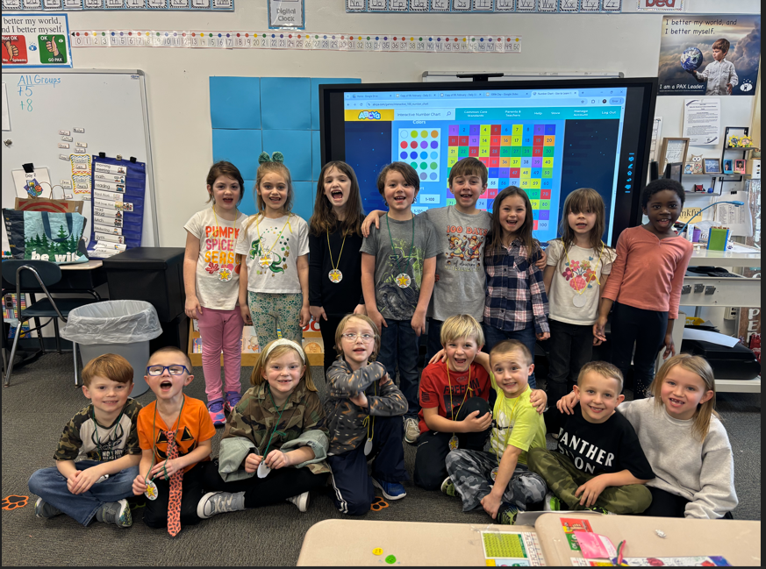
7-12 Teaching Staff Points
Over the course of eight years, we reduced the number of teachers by two.
Unfortunately, we have one less World Language teacher with elimination of the French Program, and one less business teacher.
One teacher is teaching Health at 67% of the time and English 33% of the time.

Slide 9

Administration
2023-2024 – 3 Administrators
  Superintendent
  Pk-12 Principal
  School Administrator – Athletics, Student Discipline and Teacher Evaluations
2024-2025 – 4 Administrators
  Superintendent
  Pk-12 Principal
  School Administrator assigned as CSE Chair, Special Education, & AIS
  School Administrator – Athletics, Student Discipline and Teacher Evaluations
    Until March 28, 2025
2025-2026 – 3 Administrators
  Superintendent
  Pk-12 Principal – including Athletics, Student Discipline and Teacher Evaluations
  School Administrator assigned as CSE Chair, Special Ed., AIS & Professional Development
We have reduced the number of School Administrators for 2025-2026 to 3 administrators.

Slide 10

Athletic Budget
Athletic Programs
  Soccer (Boys and Girls Varsity and Modified)
  Basketball (Boys and Girls Varsity, JV, and Modified)
  Cheer Team (Varsity)
  Baseball (Boys Varsity and Modified)
  Softball (Girls Varsity and Modified)

